Slide 1
Innovational Project for MIPT
Serikov Vasily B03-102

Slide 2
Plan
Introduce
What I realized
Situations where it is using
It allows
The goal

Slide 3
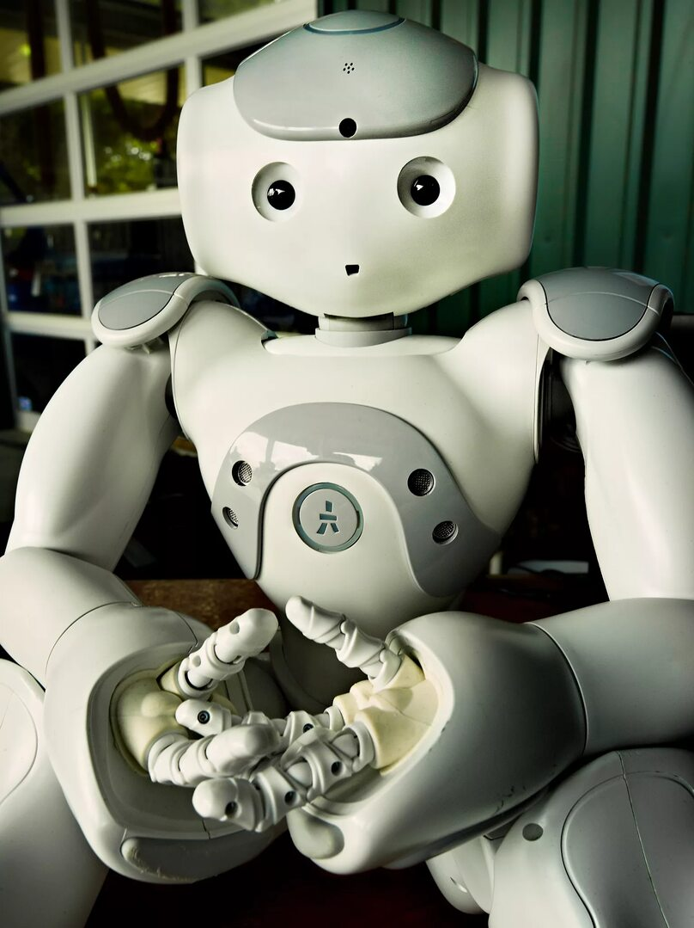
Robot - MIPT

